Slide 1
The great heroes before Trojan War
第六組
10544002 林思嫺
10544003 黃詩茜
10544013 彭鈺琪
10544015 廖潔瀅
10544017 黃家儀
10544029 陳冠妤
10544033 翁憶婷
10544088 陳姿妤
10546023 郭禹境
10546024 王碩毅

Slide 2
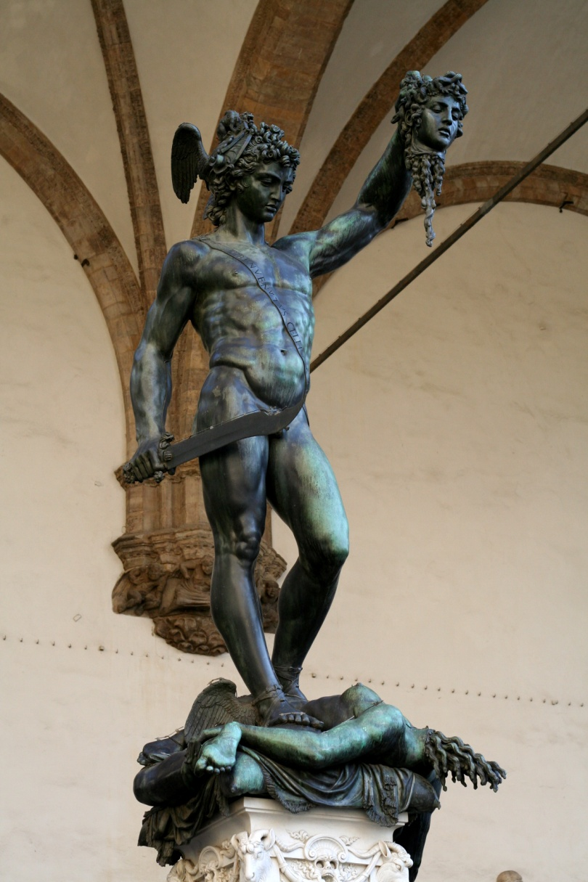
Perseus
King Acrisius of Argos had only one child, a daughter, Danaë. She was beautiful above all the other women of the land, but this was small comfort to the King for not having a son. He journeyed to Delphi to ask the god if there was any hope that some day he would be the father of a boy. The priestess told him no, and added what was far worse: that his daughter would have a son who would kill him.
Notes:
(柏修斯與梅杜莎的屍首)
阿果斯國王阿克瑞瑟斯，有個獨生女丹娜葉；她的美貌全國無人能比，但是國王一直很遺憾沒有個兒子。有天國王來到戴爾菲城(也就是阿波羅神諭處所)問卜，將來是否有希望有個兒子。女祭司告訴他沒有，而更糟糕的是他的外孫將會殺了他。

Slide 3
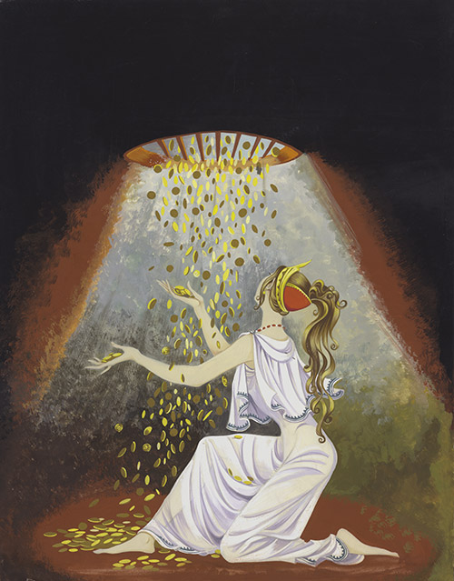
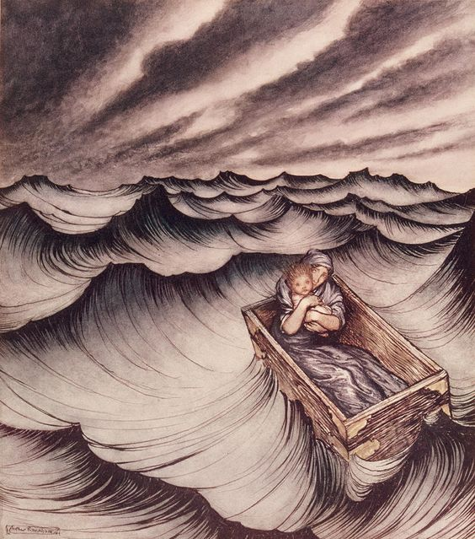
A shower of gold fell from the sky and filled her chamber and Danae she knew that the child she bore was Zeus’ son.
Acrisius put them in the chest and cast it into the water.
Notes:
唯一能夠擺脫命運的方法就是立刻處死丹娜葉，但阿克瑞瑟斯不願這麼做，因為他曾經看過屠害血親的殘酷懲罰。於是，他建造了一棟埋於地下牢房並把丹娜葉關入並嚴加看管。
有一天在地牢裡發生奇妙的事，一陣黃金雨灑落而滲入。丹娜葉知道那是宙斯以黃金雨形態看望她，並且懷了宙斯的兒子─柏修斯。阿克瑞瑟斯得知知後非常生氣，尤其丹娜葉所生的是個男孩，阿克瑞瑟斯深怕女祭司的預言成真卻又不敢殺害自己的親生骨肉，於是將丹娜葉和柏修斯關進木箱並丟入大海。

Slide 4
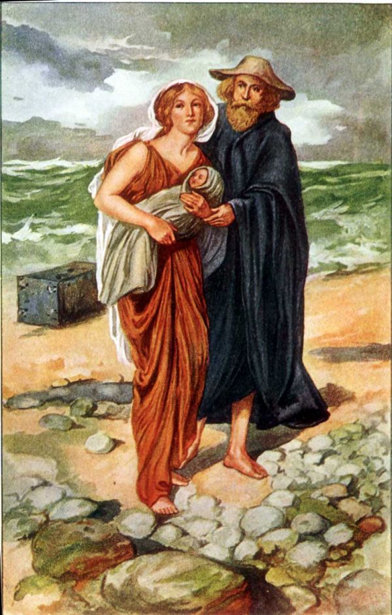
Fate willed it--or perhaps Zeus, who up to now had done little for his love and his child---that they should be discovered by a good man, a fisherman named Dictys. He came upon the great box and broke it open and took the pitiful cargo home to his wife who was as kind as he. They had no children and they cared for Danaë and Perseus as if they were their own. The two lived there many years, Danaë content to let her son follow the fisherman’s humble trade, out of harm’s way. But in the end more trouble came. Polydectes, the ruler of the little island, was the brother of Dictys, but he was a cruel and ruthless man. He seems to have taken no notice of the mother and son for a long time, but at last Danaë attracted his attention. She was still radiantly beautiful even though Perseus by now was full grown, and Polydectes fell in love with her. He wanted her, but he did not want her son, and he set himself to think out a way of getting rid of him.
Notes:
丹娜葉和柏修斯在海上漂流許久之後，被一名叫狄克堤斯好心的漁夫救起，並將他們帶上小島回家收留。漁夫夫婦對丹娜葉母子倆視如己出，原以為能就此過上寧靜幸福的生活，但卻不如他們所期望。小島的統治者波呂得克忒斯是狄克堤斯的兄弟，個性殘暴無禮，在過了很長一段時間後發現丹娜葉的存在而被她的美貌吸引，但是波呂得克忒斯只想得到丹娜葉不要他的兒子，就想盡辦法要將他除掉，而此時柏修斯已經是個長大的少年了。

Slide 5
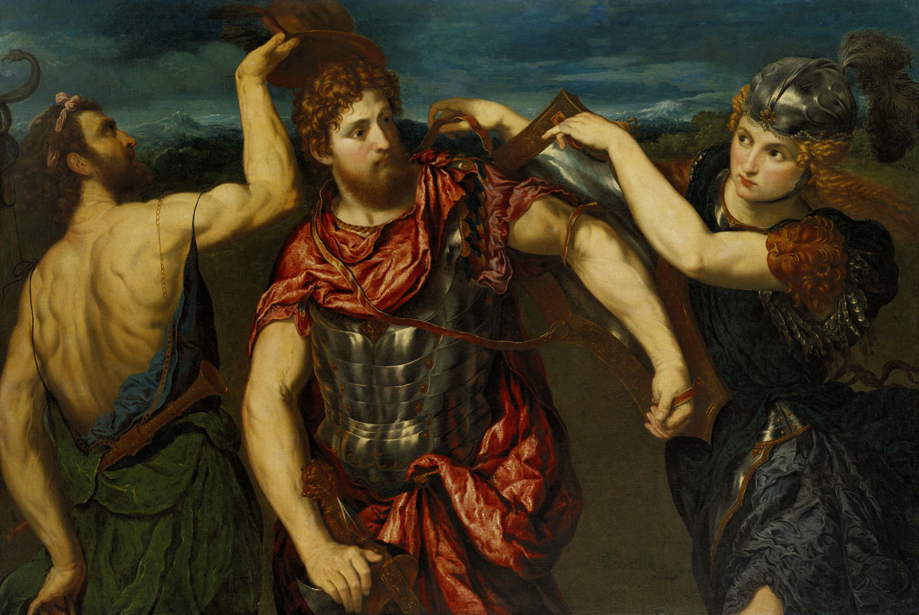
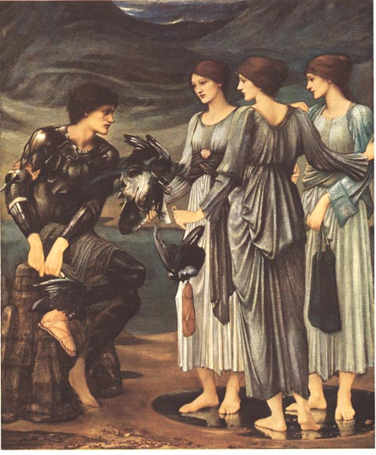
Hermes and Athena came to help Perseus
The three nymphs
Notes:
一種被稱之為郭貢的可怕怪物棲息在島上，因為致人於死的威力非常強大而有名。波呂得克忒斯告訴柏修斯他最想做的事就是取下任何一隻怪物的頭顱，他認為這是能夠除掉柏修斯最好的辦法。在波呂得克忒斯的婚禮上每個賓客都會送上一份禮物，唯獨柏修斯沒有禮物可以給，於是他宣布將會完成國王的願望去殺死怪物梅杜莎並取下他的頭顱當作禮物現給國王。任何看到梅杜莎的人會立刻變成石頭，但幸運的是，有兩位偉大的神赫密士與雅典娜前來幫助他。赫密士給了一把能擊敗任何堅硬怪物的劍，而雅典娜給了能當鏡子反射的盾牌。赫密士告訴柏修斯，在他攻擊梅杜莎之前，他必須先向北方精靈取得裝備。要找到精靈的居所，就必須去找灰女，唯有她能告訴他們去路。實際上，她們是奇異的仙女，最奇特的是她們三人共用一只眼睛，她們的習慣是輪流使用，每一次要使用時，才從使用人移到要用的人的額頭。赫密士計謀親自帶領柏修斯找到精靈，一到那兒，柏修斯必須先躲藏；直到他看到其中一位精靈，從額頭取下眼睛交到另一位精靈手中。就在移交眼睛那一刻，三位精靈都看不見時，柏修斯必須趕快衝向前搶下眼睛而拒絕交還，除非精靈告訴他如何找到北方精靈。

Slide 6
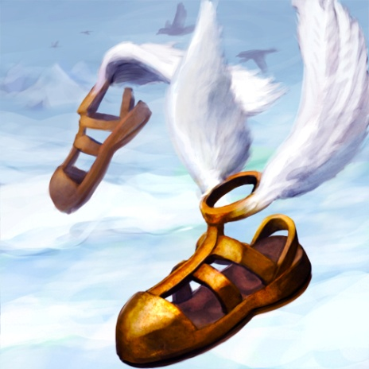
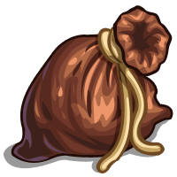
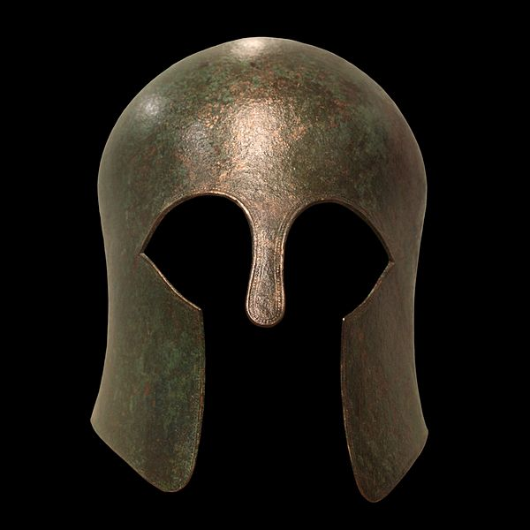
Three gifts
winged sandals
a magic wallet which would always become the right size for whatever was to be carried in it
a cap which made the wearer invisible.
Notes:
北方精靈給了柏修斯三件重要的禮物
1.有翅膀的拖鞋
2.能隨著裝填物品變化大小的魔囊
3.能讓人帶上而隱形的魔帽

Slide 7
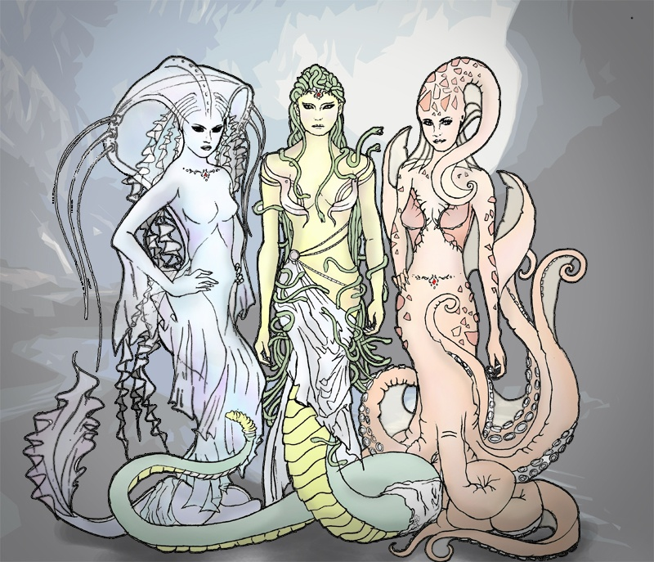
Gorgons-Medusa and her sisters
With a single sweep of his sword he cut through her neck and he swooped how enough to seize the head. He dropped it into the wallet.
Perseus was safe; he had on the cap of darkness and they could not find him.
Notes:
當柏修斯趁著郭貢熟睡的時候將梅杜莎的頭砍下裝進魔囊，在隱形頭盔的幫助下柏修斯順利逃走而不被梅杜莎的姊妹發現。

Slide 8
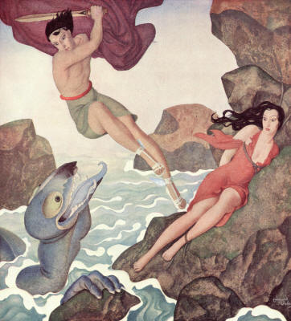
Perseus saved Andromeda
On his way back he came to Ethiopia and alighted there. By this time Hermes had let him. Perseus found, as Hercules was later to find, that a lovely maiden had been given up to be devoured by a horrible sea serpent. Her name was Andromeda.
Notes:
在回程的路上柏修斯拯救了一名差點被怪獸吃掉的女孩─安朵美達，兩人結婚後返回，發現母親丹娜葉為了躲避國王的求婚而隱居。

Slide 9
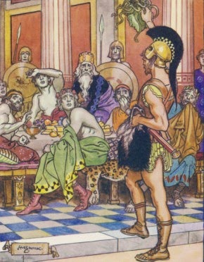
Perseus drew the eyes of every man there. Then before any could look away he held up the Gorgon’s head. And at the sight one and all, the cruel King and his servile courtiers, were turned into stone.
Notes:
隨後柏修斯得知國王要舉辦一場盛宴，他就帶著梅杜莎的頭前去，並在大家都注意它的時候把梅杜莎的頭顱展示出來，一瞬間，所有人都變成了石頭，也包含國王。國王死後柏修斯將漁夫狄克斯特立維新的國王。然後與安朵美達回到家鄉希臘，抵達時發現他的爺爺阿克瑞瑟斯不見蹤影。某一天柏修斯參加了一個運動會，卻在擲出鐵盤時砸死了一個站在觀眾席的人，那人正好是它的爺爺阿克瑞瑟斯。也印證了一開始阿波羅的預言─阿克瑞瑟斯會被自己的孫子殺死。後來柏修斯與安朵美達生下一個兒子叫伊萊特萊翁，也就是海力克斯的祖父。

Slide 10
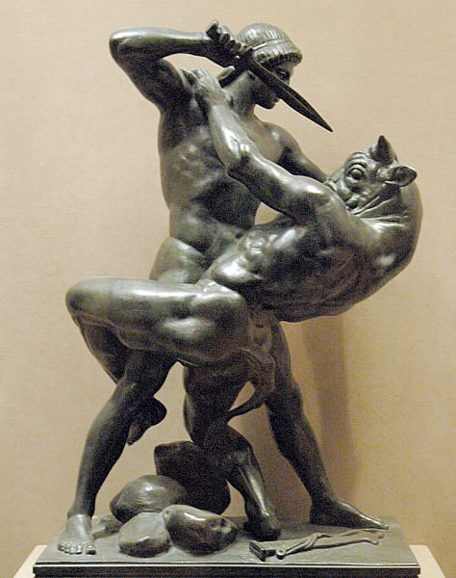
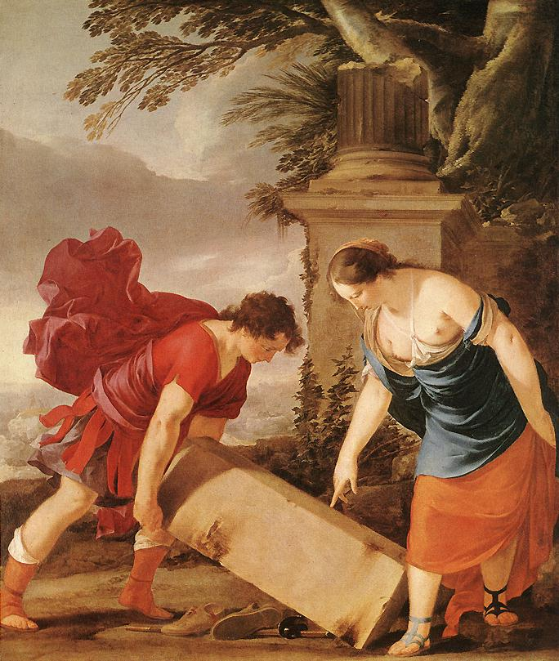
Theseus “Nothing without Theseus”
son of the Athenian King, Aegeus
Became a most wise and disinterested King of Athens
Notes:
忒修斯是雅典國王愛琴斯的兒子，年輕時在希臘南方他母親的家度過，愛琴斯在孩子出生前回到雅典。但是在愛琴斯離開前已先於空洞中擺了把劍與一雙鞋子，並蓋上大石頭；他這麼做他的太太知道並告訴太太說，如果是男孩，等到孩子長得夠壯能夠滾動石頭,就取出洞內物品。她可以送忒修斯到雅典，並宣告愛琴斯是他的父親。小孩是個男生，長得比其他人健壯；所以他的母親帶她去洞口搬動石頭時，他一點都不吃力。他的母親告訴他，該是去尋找他父親的時候了，而且船他的祖父已經備妥供他使用；但是忒修斯拒絕經由水路前往，因為航海輕鬆而安全。他的理想是儘可能快點成為大英雄，而輕鬆安全肯定不是成為英雄的方法。海力克斯是所有希臘英雄中最為偉大，而決定自己就要跟他一樣；因此忒修斯堅決拒絕他母親與祖父鼓勵搭船，說搭船是逃離危險的卑鄙行徑，而他經由陸路出發前往雅典。因為一路上強盜騷擾，而路程又長又危險；可是忒修斯把盜匪全殺了。

Slide 11
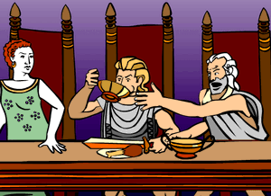
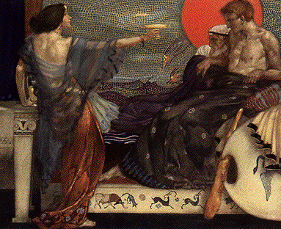
Medea tried to poison Theseus
Notes:
當他抵達雅典時，他已是家喻戶曉的英雄。國王愛琴斯邀約設宴款待，不知道忒修斯是他的兒子。事實上國王愛琴斯害怕年輕人的盛名，想他可能贏得百姓推舉為國王，而美狄亞企圖毒害忒修斯。美狄亞交給愛琴斯下毒的杯酒，但忒修斯希望立刻跟父親相認，抽出了劍；國王愛琴斯立即認出那把劍，把杯酒潑灑了一地。美狄亞件事蹟敗露就施一貫伎倆逃之夭夭。愛琴斯隨後對國人宣布，忒修斯是他兒子與繼承人。

Slide 12
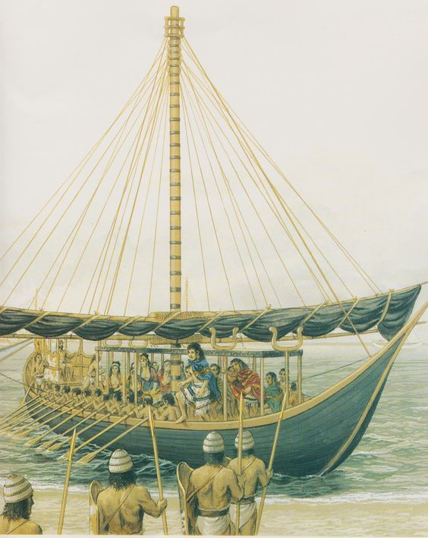
Tribute for Crete
Minos invaded the country, captured Athens and declared that he would raze it to the ground unless every nine years the people sent him a tribute of seven maidens and seven youths.
Notes:
在忒修斯抵達雅典之前數年，雅典發生可怕的厄運。克里特島強權統治者米諾斯的獨子安德羅鳩士，去拜訪雅典國王愛琴斯時丟了性命。米諾斯入侵雅典，俘虜了雅典人並詔告要摧毀雅典，除非每九年人民要送給他七位童男、童女做為獻禮米諾陶吞食。米諾陶是頭半牛半人的怪物，米諾斯夫人帕西法厄與一頭漂亮的公牛所生的後代。波西頓送這頭公牛給米諾斯，是為了米諾斯應殺了公牛而獻祭給他；但是米諾斯不忍殺了公牛而據為己有。為了懲罰米諾斯，波西頓使帕西法厄瘋狂愛上公牛。

Slide 13
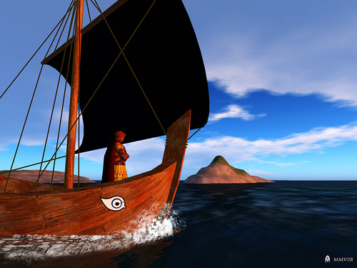
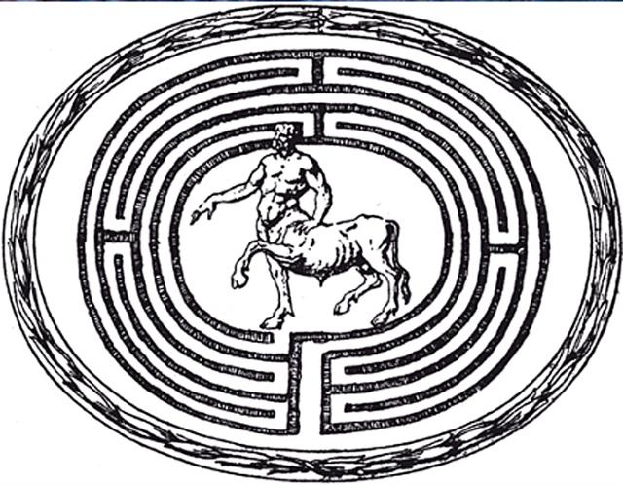
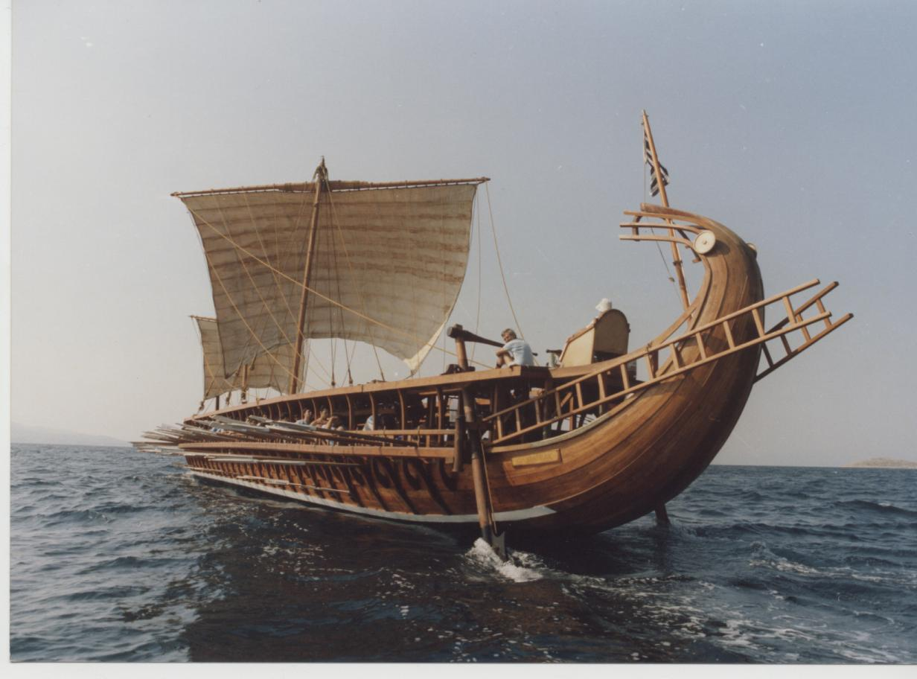
Daedalus built the Labyrinth, famous throughout the world. Once inside, one would go endlessly along its twisting paths without ever finding the exit.
He told his father and promised him that if he succeeded, he would have the black sail to a white one, so that Ageseus could know that his son was safe.
Notes:
米諾斯要偉大的建築師兼發明家戴德勒斯，為他建構不可能逃脫的幽禁處所，戴德勒斯建了迷宮而馳名於世。一個人一旦進了迷宮，會沿著迂迴曲折的路徑永無止境地走而找不到出口。雅典的童男、童女每次被送到迷宮來，留給米諾陶。不可能有脫逃的方法。獻忒修斯立刻出面而自願成為犧牲者，大家都對他的善良喜愛有加而且激賞他的高貴情操。特修斯告訴他的父親愛琴斯他會殺掉米諾陶，並承諾如果他成功了，會把總是代表船難懸掛的黑帆換成白帆讓愛琴斯在船靠岸之前就能知道忒修斯是安全歸來的。

Slide 14
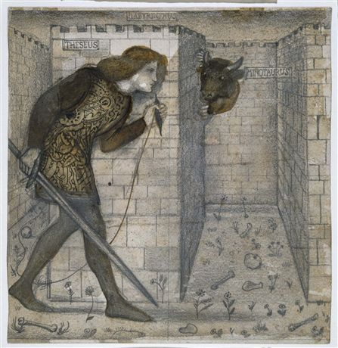
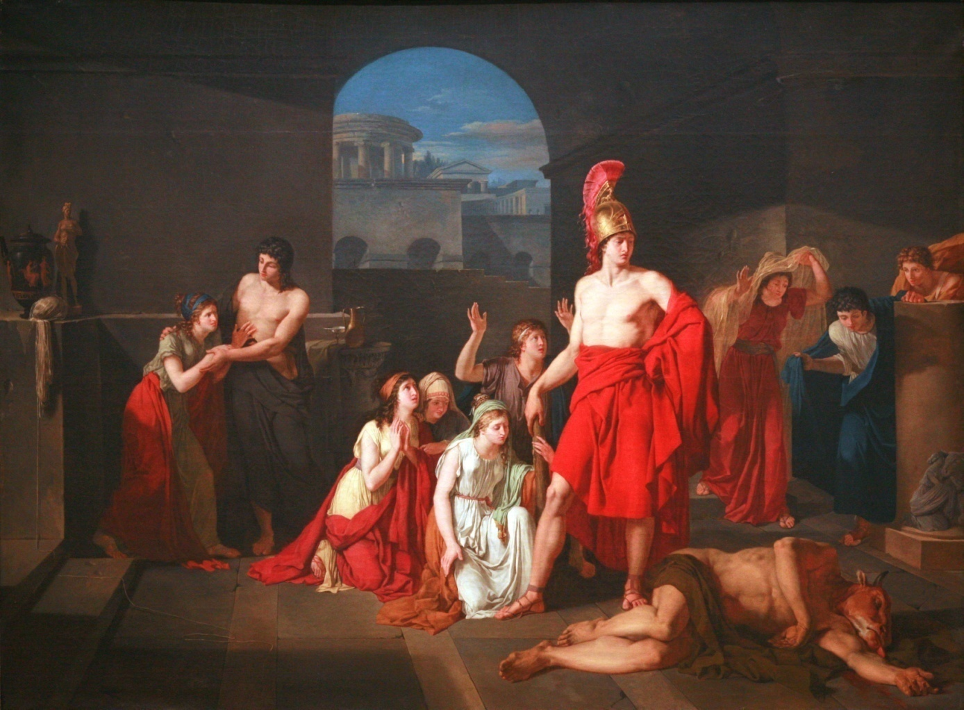
Thesues killed Minotaur
Notes:
忒修斯在島上遇見米諾斯的女兒阿麗阿德涅，而當忒修斯列隊走過她面前時，卻對忒修斯一見鍾情。阿麗阿德涅請來戴德勒斯，要他務必告訴她逃出迷宮的方法；而阿麗阿德涅也請來忒修斯告訴他，如果他承諾帶她回雅典並娶她，會引導他逃出迷宮。忒修斯大膽地走入迷宮尋找米諾陶，他碰見了熟睡的米諾陶並擊倒牠，緊緊地把牠抵在地面上。

Slide 15
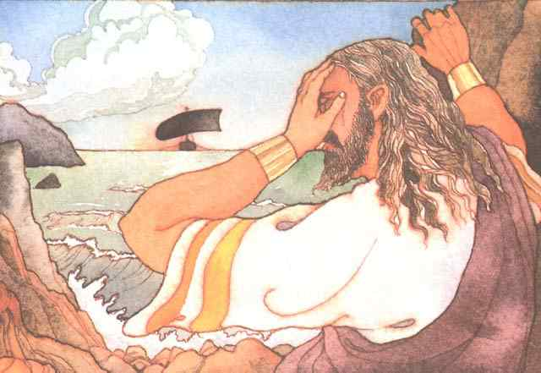
The black sail was seen by his father, King Aegeus, from the Acropolis, where for days he had watched the sea with straining eyes. It was to him the sign of his son’s death and he threw himself down from a rocky height into the sea, and was killed. The sea into which he fell was called the Aegean ever after.
Notes:
殺死米諾陶後，忒修斯帶著阿麗阿德涅逃上船航向雅典。在途中阿麗阿德涅病死了。他們航近雅典時，忒修斯因為太過傷心而忘了掛上白帆報平安，父王愛琴斯在雅典岸邊癡癡望著海上，日以繼夜的等待卻看到了黑帆，愛琴斯以為兒子已經死亡，傷心欲絕的跳海自殺了，而他落海之處從此之後名為愛琴海。

Slide 16
So Theseus became King of Athens, a most wise and disinterested king. He declared to the people that he did not wish to rule over them; he wanted a people’s government where all would be equal. He resigned his royal power and organized a commonwealth, building a council hall where the citizens should gather and vote. The only office he kept for himself was that of Commander in Chief. Thus Athens became, of all earth’s cities, the happiest and most prosperous, the only true home of liberty, the one place in the world where the people governed themselves.
Notes:
忒修斯成為雅典最聰明與公正的國王，他向人民詔告他不希望來統治他們，他要有個人民政府而所有百姓平等。他辭去他的王權、組織共和國、建立議事廳供公民集會與投票，他唯一為自己保留的是議事主席的職位。因此雅典變成全球最幸福與繁榮的都市、自由唯一真正的家園、世上第一個人民管理自己的地方。

Slide 17
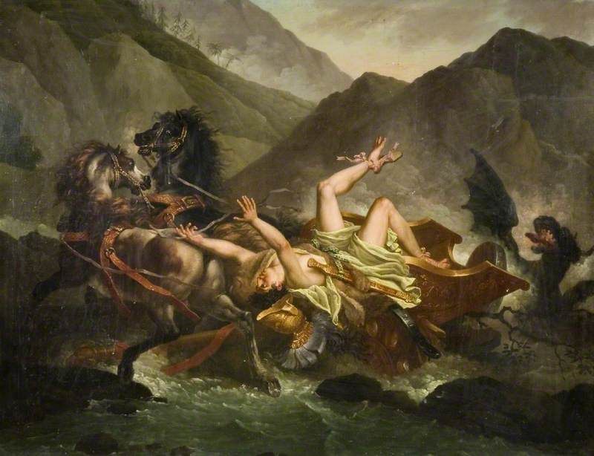
In the latter years of his life Theseus married Ariadne’s sister Phaedra, and drew down terrible misfortunes on her and on himself and on his son Hippolytus, the son the Amazon had borne him.
She fell in love with him, madly and miserably, overwhelmed with shame at such a love, but utterly unable to conquer it. Aphrodite was back of this wretched and ominous state of affairs. She was angry at Hippolytus and determined to punish him to the utmost.
Notes:
希波呂托斯是忒修斯與亞馬遜女王安提俄珀之子。淮德拉是忒修斯後來的妻子並成為希波呂特斯的繼母。希波呂托斯輕視阿芙羅狄忒而尊崇阿耳忒彌斯，於是阿芙羅狄忒為了懲罰他，讓淮德拉愛上了繼子。希波呂托斯拒絕了淮德拉的示愛。於是淮德拉對忒修斯說希波呂托斯強姦了自己然後上吊自殺。忒修斯信以為真，將希波呂特斯驅逐流放。後來希波呂托斯騎的馬為海怪所驚、跌墜而亡。

Slide 18
Theseus’ death
Theseus’ death, also, was wretched. He was at the court of a friend, King Lycomedes, where a few years later Achilles was to hide disguised as a girl. Some say that Theseus had gone there because Athens had banished him. At all events, the King, his friend and his host, killed him, we are not told why.
Notes:
忒休斯的死也是非常的悲慘，幾年後他在朋友呂科默德斯國王的庭上，阿基里斯藏身假扮女侍。有人說忒修斯是因為貝雅典放逐才去了那裡。但忒修斯被它的主人及朋友殺死了，而原因並沒有人知道。

Slide 19
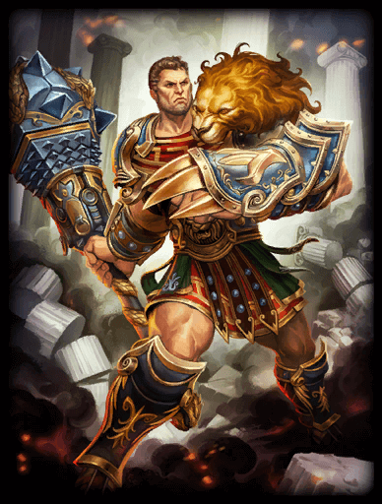
Hercules
Derived from Hēra "Hera" and kleos "Glory", Hercules is known as Hera's glory.
The greatest hero of Greece was Hercules.
He was what all Greece except Athens most admired.
Hercules embodies what the rest of Greece in general honored and admired.
Notes:
海力克斯的名稱引申自赫拉(Hera)和Kleos(榮耀)，故海力克斯也被稱為「赫拉的榮耀」。
海力克斯是希臘最偉大的英雄，他跟另一位雅典英雄忒修斯地位完全不同，海力克斯是全希臘除了雅典之外最受景仰的人物。
忒修斯體現了雅典人的觀念，而海力克斯則體現希臘最重視的其他部分，他的特質是一般希臘人所尊崇與景仰。

Slide 20
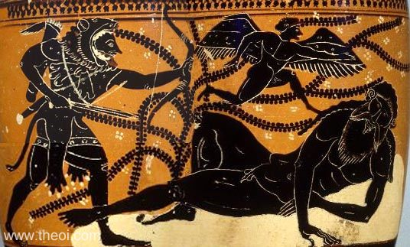
Hercules was the strongest man on earth and he had the supreme self-confidence himself on en equality with the gods-and with some reason.
They needed his help to conquer the Giants.
Hercules treated the gods accordingly.
Once when the priestess at Delphi gave no response to the question he asked, he seized the tripod she sat on and declared that he would carry it off and have an oracle of his own.
Notes:
海力克斯是大地最健壯的男人，而對自己有絕對的自信，而因著某些理由與眾神平起平坐。
奧林匹亞眾神需要海力克斯的協助去征服巨人族。
海力克斯相對地對待諸神，有一次戴菲爾女祭司沒有回答他的問題，海力克斯搶走她坐的三角凳並揚言要帶走它並擁有自己的神諭。當然阿波羅無法忍受，可是海力克斯願意與阿波羅一較高下，因此宙斯必須調停，然而紛爭輕易擺平，海力克斯對紛爭心平氣和，他不想跟阿波羅起爭執，阿波羅易地而處，面對這位無畏無懼的勇士心生仰慕。

Slide 21
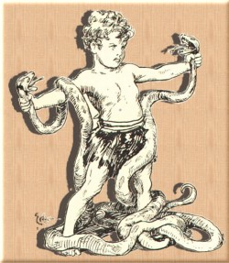
He was born in Thebes and for a long time was held to be the son of Amphitryon, a distinguished general. But in reality he was the son of Zeus. Amphitryon’s wife Alcmena born two children, Hercules to Zeus and Iphicles to Amphitryon.
When all was silent in the house two great snakes came crawling into the nursery. The children woke. Iphicles screamed and tried to get out of bed, but Hercules sat up and grasped the deadly creatures by the throat. They turned and twisted and wound their coils around his body, but he held them fast.
Notes:
海力克斯出生在底比斯，長期以來被認為是傑出將軍安菲特律翁的兒子，但是實際上海力克斯是宙斯的兒子，安菲特律翁將軍在外征戰時，宙斯化身安菲特律翁來找他的妻子(阿爾喀美娜)，她生了兩個小孩，海力克斯屬於宙斯而伊菲克勒斯屬於安菲特律翁。兩個男孩在他們一歲之前，當險惡來到他們面前時，展現的方式清楚地顯現出不同。
一天晚上阿爾喀美娜給兩個小孩洗完澡、餵了奶並把他們放入嬰兒床內，她推動著搖籃，一會兒兩個嬰兒入睡了，但是在最暗的半夜，屋內一切靜默寂靜，兩條蛇爬入嬰兒房；房內有亮光，兩條蛇爬上嬰兒床，搖晃著蛇首、吞吐蛇信，而孩子們醒了過來。伊菲克勒斯大聲尖叫而試圖爬出床外，但是海力克斯坐了起來且抓住這致命生物的喉部，兩條蛇轉頭並扭動緊繞而盤住海力克斯的身體，但是他握住它們更緊。媽媽聽到伊菲克勒斯尖叫，呼叫她的丈夫衝到嬰兒房。海力克斯坐著微笑，每隻手個抓著癱軟的蛇身，幸災樂禍地把兩條死蛇交給安菲特律翁。那時大家才知道海力克斯這孩子，注定要成就大事。

Slide 22
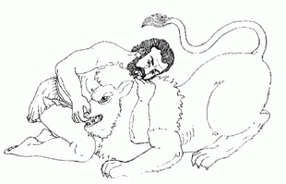
Hercules seems not to have liked music, which was a most important part of a Greek boy’s training, or else he dislikes his music master. He flew into a rage with him and brained him with his lute.
By the time he was eighteen he was full-grown and he killed, alone by himself, a great lion which lived in the woods of Cithaeron, the Thespian lion. Ever after he wore its skin as a cloak with the head forming a kind of hood over his own head.
Notes:
對海力克斯的教育費了極大心血，教他不想學的事情是非常危險的。音樂是希臘男孩的訓練最重要一部分，他似乎不喜歡音樂，否則他不會不喜歡他的音樂老師，他突然對音樂老師發飆，並用魯特琴砸了老師腦袋，這是他第一次無意使出致命一擊。他無意要殺掉可憐的音樂家，只是一時衝動揮出，欠缺考慮不曉得力量的輕重。他很難過、非常難過，但是卻沒能防止他一而再地發生同樣的事。他所學的其他科目劍擊、摔角、騎馬，幸好他尤其好學，而這些老師才得以全倖免於難。等到十八歲他長大成人，獨自一人殺掉一頭生活在西塞隆森林內的帖斯比亞獅子；此後他披著獅皮當斗篷，以獅頭套著他的頭當成一種風帽。

Slide 23
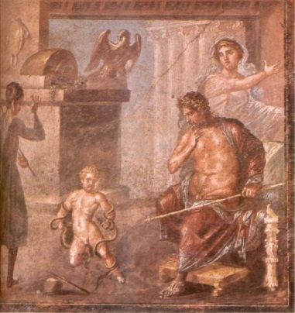
His next exploit was to fight and conquer the Minyans, the grateful Thebes citizens gave him as reward the hand of the Princess Megara. He was devoted to her and to their children and yet this marriage brought upon him the greatest sorrow of his life as well as trails and dangers such as no one ever went through, before or after. When Megara had borne him three sons he went mad. He killed his children and Megara, too, as she tried to protect the youngest.
Notes:
海力克斯另一項功績是戰勝明彥族，底比斯市民為感謝他而把公主梅格拉嫁給他做為賞賜，海力克斯鍾愛她和孩子們，然而這門婚姻帶給他畢生最大的傷痛以及連串危難，梅格拉為海力克斯生下三個兒子後他發瘋了，赫拉從沒忘記她的壞心眼，使海力克斯發瘋為樂，海力克斯殺了自己的小孩，而梅格拉試圖保護小孩們也被殺了。等他恢復理智，他發現自己在血跡斑斑的大廳，兒子與太太的屍體就在他身旁。他不知道怎麼回事，也不知道他們怎麼被殺。他站在大廳驚惶失措狂吼，受驚嚇的人們站得遠遠地旁觀，等海力克斯神志清醒，安菲特律翁才敢靠近他。沒什麼好隱瞞海力克斯的，他必須知道可怕事件怎麼發生的，安菲特律翁告訴了他。

Slide 24
Hercules : And I myself am the murderer of my dearest.
Amphitryon : Yes, But you were out of your mind.
Hercules: Shall I spare my own life then? I will avenge upon myself these deaths.
Theseus : Do not start back, do not keep me from sharing all with you. Evil I share with you is not evil to me. And hear me. Men great of soul can bear the blows of heaven and not flinch.
Hercules : What can I do but die? Live? A branded man, for all to say, look. There is he who killed his wife and sons! Everywhere my jailers, the sharp scorpions of the tongue!
Theseus : Even so, suffer and be strong, you shall come to Athens with me, share my home and all things with me. And you will give to me and to the city a great return, the glory of having helped you.
At Delphi where he went to consult the oracle, the priestess looked at the matter just as he did. He needed to be purified, she told him, and only a terrible penance could do that.
Notes:
海力克斯並沒有聽進去安菲特律翁的話，關於他當時是意識不清，他無法原諒自己，他衝出去自殺、但卻在開始動手之前，他絕望的念頭有了變化而他的生命得到饒恕。從發了狂的狀態與殘暴的行為，海力克斯回復清醒理性與傷痛容忍的奇蹟，真的是奇蹟，絕非來自上天下凡之神所施加，卻是人類友誼奇蹟所導致。海力克斯的朋友忒修斯站在他面前，伸出雙手抓住海力克斯滿是血腥的手，依據一般希臘的觀念，忒修斯自己沾染了海力克斯的罪孽而承受了一部分的罪。
忒修斯告訴海力克斯：「你要跟我回到雅典，住到我家跟我共享所有一切；你會帶給我和這個城市極大回報，這回報是我協助你的榮耀。」
接著靜默好久，最後海力克斯慢條斯理而沈重地說：「就順其自然吧！我會堅強而等待死亡降臨。」
兩人來到雅典，但是海力克斯沒有停留很久。忒修斯這位思想家，他不認同這種觀念，當一個人並不知道他所做的而被視同為殺人罪、以及去幫助的這個人被視為玷污。雅典人同意並歡迎這位可憐英雄，但是海力克斯他自己無法瞭解這種觀點，他來到戴爾菲徵詢神諭，女祭司檢視了他所做的事件，她告訴他需要加以洗滌罪孽，而只有可怕的苦行才能辦到。她吩咐他去國王歐律斯透斯那兒，不管歐律斯透斯要求什麼，海力克斯都要完成。

Slide 25
Labours of Heracles
Neither did Eurystheus accept the killing of the Lernaean Hydra as Heracles' nephew, lolaus, had helped him burn the stumps of the heads. Eurystheus set two more tasks (fetching the Golden Apples of Hesperides and capturing Cerberus), which Heracles performed successfully, bringing the total number of tasks up to twelve.
Notes:
因為赫拉的詛咒，海力克斯在發狂中殺害了自己的孩子。為了消除這個罪惡，他被要求為他的最主要的敵人、佔了本該屬於他的王位的歐律斯透斯完成十個任務。根據預言，如果他成功完成歐律斯透斯交給他的十個任務，他的罪將被清除並獲得不朽的名聲。海力克斯完成了這些任務，但歐律斯透斯不承認清洗奧吉亞斯的牛廄的任務，因為海力克斯為這個任務索求報酬；他也不接受海力克斯殺死「九頭蛇」海德拉的任務，因為海力克斯是在他的侄兒伊奧勞斯的幫助下完成這個任務的。因此歐律斯透斯又提出了兩個新的任務，海力克斯也成功的完成了它們，並讓自己的偉業達到了十二項。

Slide 26
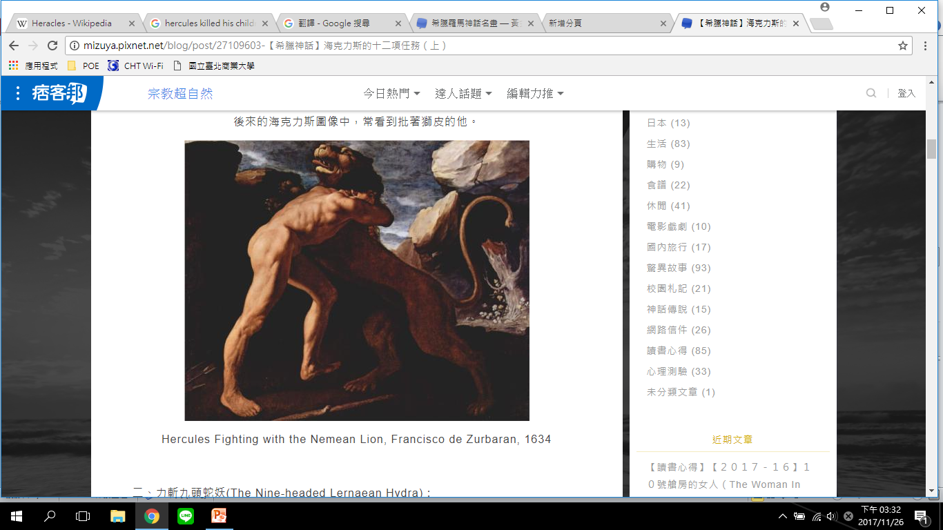
1. Slay the Nemean lion
Notes:
第一件是殺死沒有武器能傷得了的尼米亞巨獅，當海力克斯知道要去殺死獅子時，他就先砍倒了一棵橄欖樹，並以粗壯的樹幹削成結實的木棒，當海力克斯遇到獅子時，他先是用弓箭射向了獅子，無奈箭矢根本穿不透渾厚的獅子皮，反而讓獅子獸性大發朝海力克斯撲來，海力克斯拿出事前準備好的木棒，朝巨獅的腦袋用力一擊，就算是凶猛的巨獅也難逃這充滿神力的一擊，當巨獅搖搖欲墜時，海力克斯趁此時一把扼住了巨獅的喉嚨，就這樣活活的把這頭獅子掐死了，海力克斯殺死獅子後，把獅子皮剝下，披在身上，就這樣光榮的回到提林斯。

Slide 27
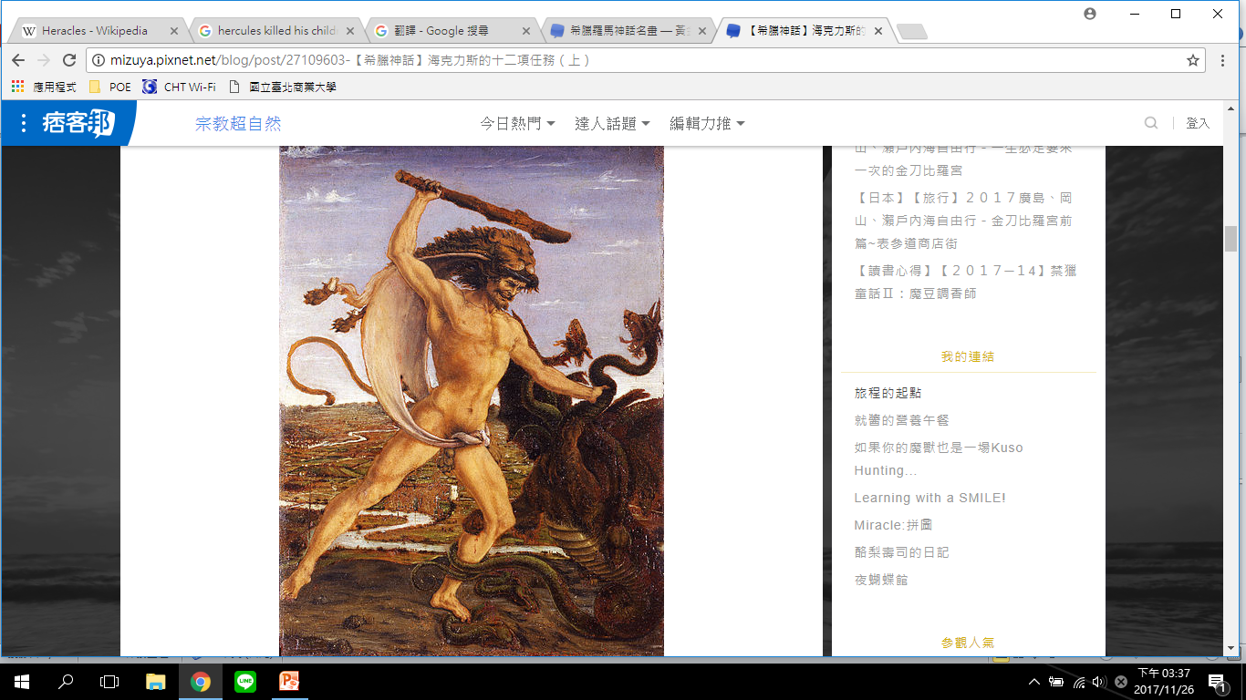
2. Slay the nine-headed Lernaean Hydra
Notes:
第二件苦役是到勒拿湖，殺死住在沼澤名為海卓拉的九頭蛇。這是件難以達成的任務，因為每顆頭都長生不死而且兇猛，當海力克斯砍下一顆頭時，反而長出兩顆。然而海力克斯在姪兒伊奧勞斯協助下，帶著姪兒的烙印鐵條，在他砍下每顆蛇頭時立刻從頸部封死，使蛇頭無法再長出。當把所有蛇頭都砍下後，他把蛇怪正中央長生不死的一顆頭，安全地埋在大岩石下。除此之外，他將箭矢都塗上蛇怪那充滿劇毒的血，此後，凡是中了海力克斯之箭的人，都無藥可醫，中毒而死。

Slide 28
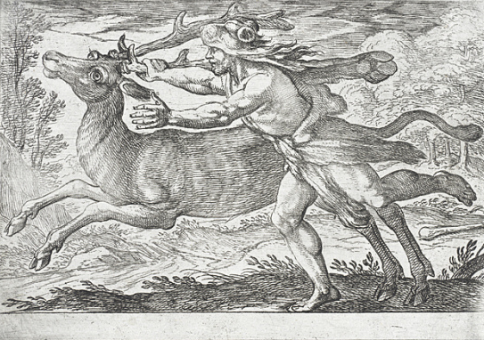
3. Capture the Golden Hind of Artemis
Notes:
第三個苦役是帶回生活在席瑞尼夏森林，亞特密斯的聖物-長著金鹿角的活母鹿。他曾輕易地殺死一頭，但是要帶回活蹦亂跳的可又是另外一回事；然而他花了整整一年追尋她的蹤跡，跑遍了希臘及色雷斯地區，最後終於在母鹿疲倦的停下來喝水時，海力克斯悄悄用箭瞄準她的後腿，嗖的一聲，母鹿應聲倒地，海力克斯才終於捉到了這頭讓他吃盡苦頭的母鹿。

Slide 29
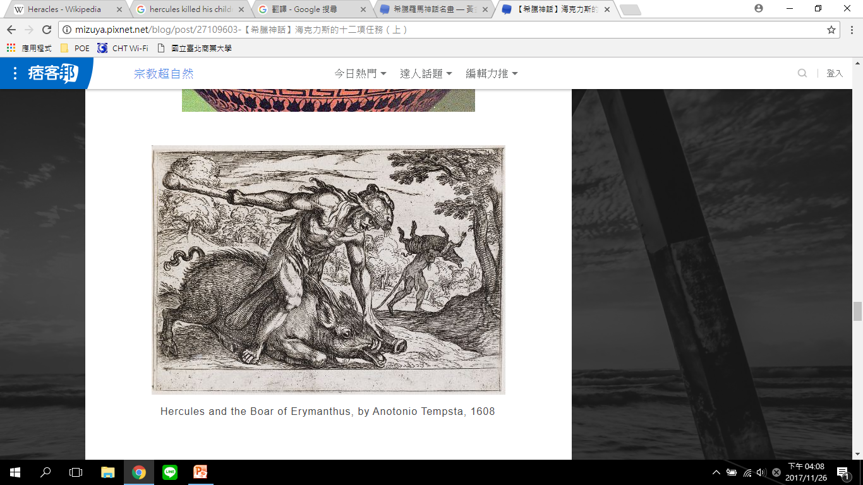
4. Capture the Erymanthian Boar
Notes:
第四個苦役是捕捉巢穴在厄瑞曼色斯山的野豬，他到處追著野豬跑，直到野豬體力不支，才把牠逐至深厚雪地而陷住。

Slide 30
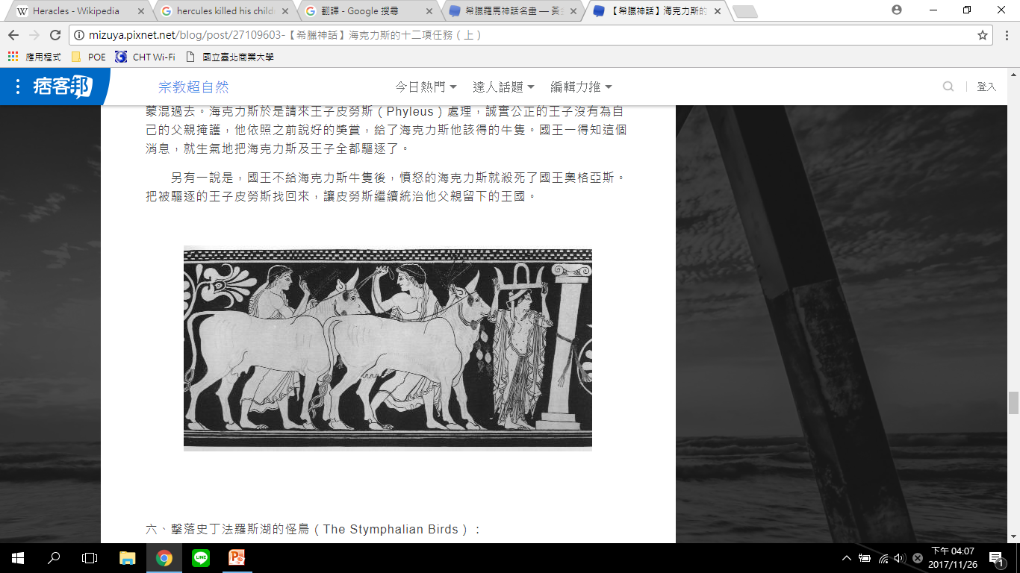
5. Clean the Augean stables in a single day
Notes:
第五個苦役是在一天之內清理奧吉亞斯的牛廄，奧吉亞斯畜養了數千頭牛而廄欄已經數年未曾清掃。海力克斯使兩條河流改變河道，以河水淹入牛廄立刻把污垢清洗的清潔溜溜。

Slide 31
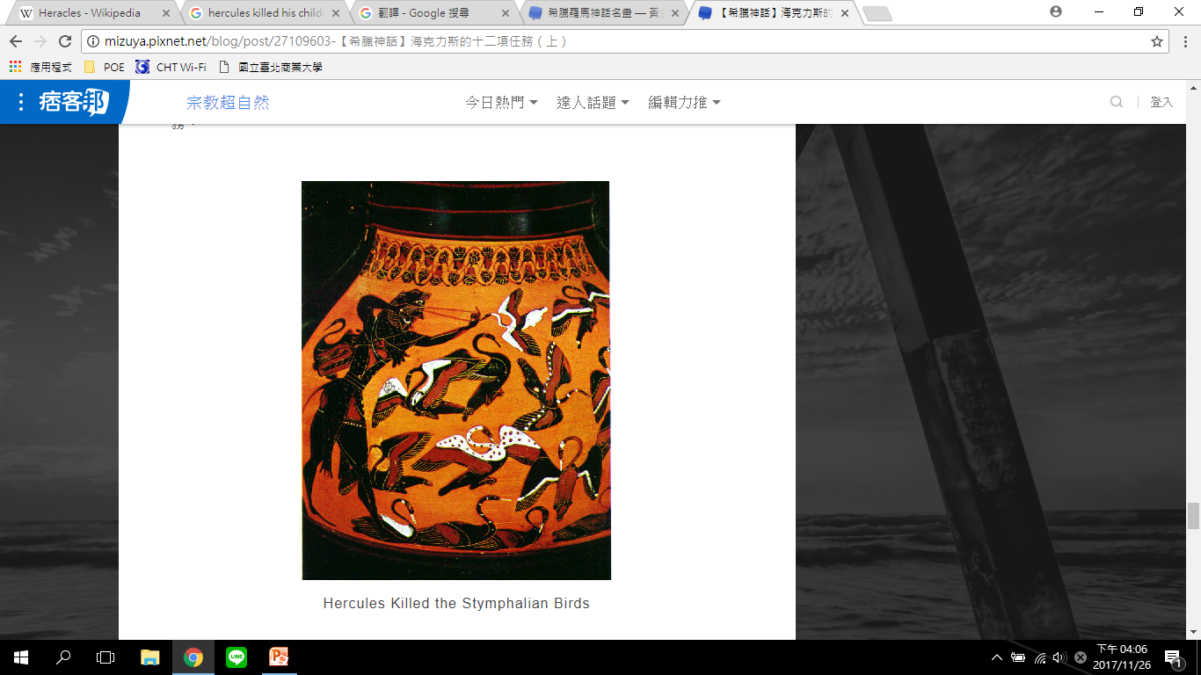
6. Slay the Stymphalian Birds
Notes:
第六個苦役是驅趕斯廷法利恩鳥，因為鳥隻數量龐大，對斯廷法勒斯百姓來說是個長期禍害。海力克斯透過雅典人的協助把鳥隻趕出隱蔽處所，而在牠們傾巢而出時加以射殺。

Slide 32
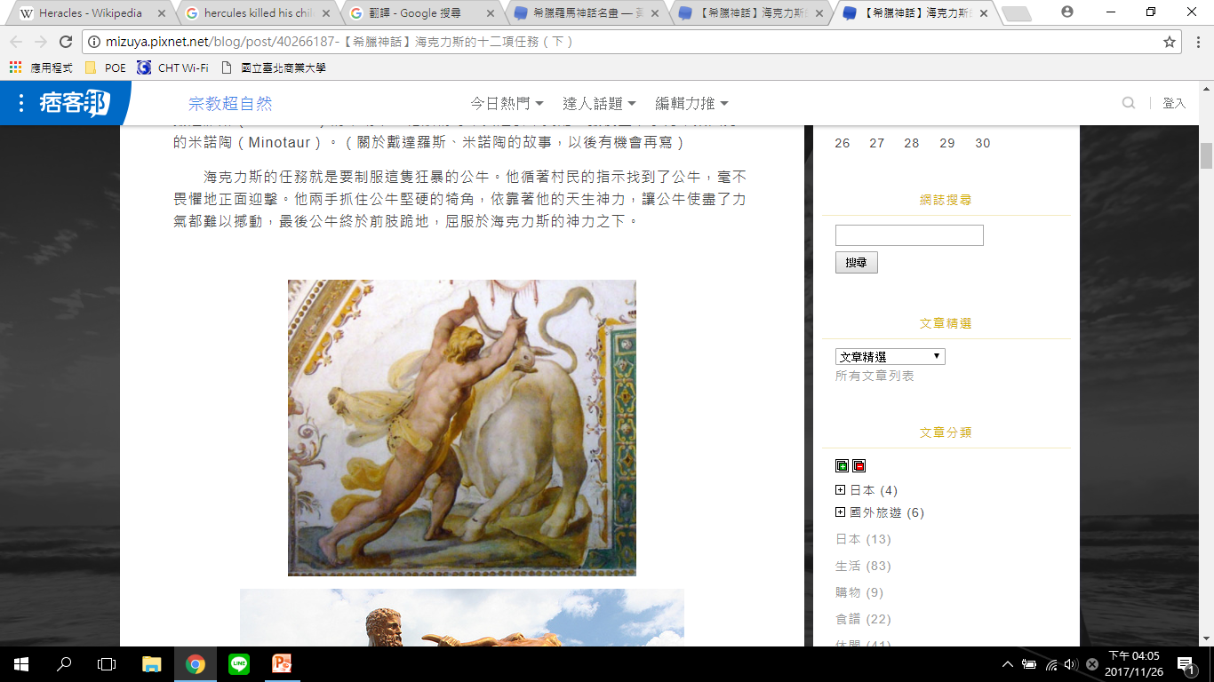
7. Capture the Cretan Bull
Notes:
第七個苦役是去克里特島，帶回海神波賽冬送給克里特島國王米諾斯的那頭漂亮兇猛公牛。海力克斯依循著村民的只是找到了發狂的公牛，毫不畏懼的正面迎擊，他兩手抓住公牛堅硬的犄角，依靠著他天生的神力，使公牛使盡了力氣都無法撼動，最終馴服了公牛，將之帶上船送給了歐律斯透斯。

Slide 33
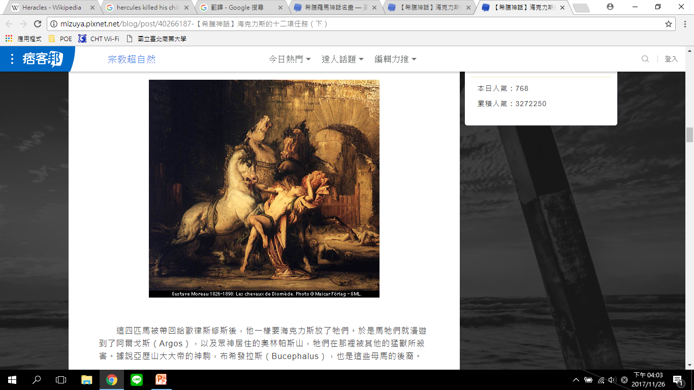
8. Steal the Mares of Diomedes
Notes:
第八個苦役是得到瑟雷斯國王狄俄墨得斯的食人牝馬群，海力克斯先殺了狄俄墨得斯，然後在毫無阻力下驅走牝馬群。

Slide 34
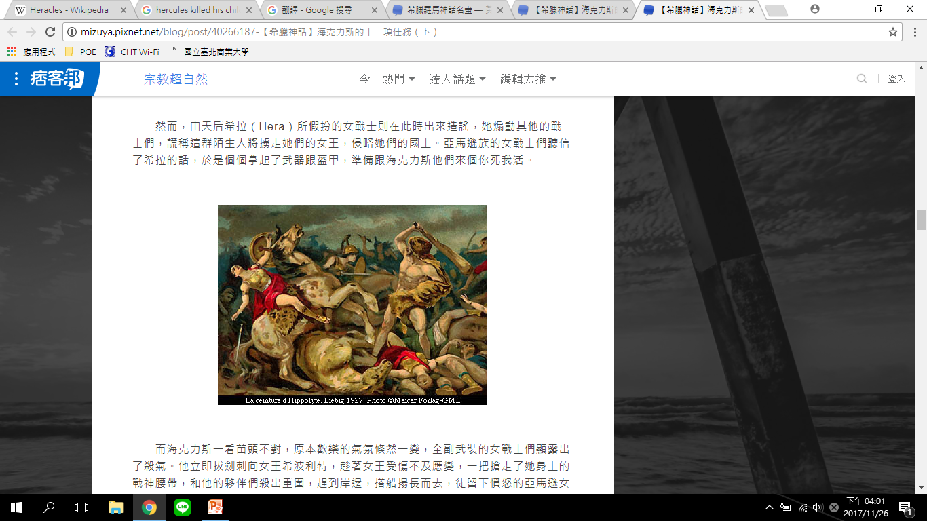
9. Obtain the girdle of Hippolyta, Queen of
the Amazons
Notes:
第九個苦役是帶回亞馬遜皇后希波呂忒的腰帶，海力克斯抵達亞馬遜女戰士國，希波呂忒很親切和他面見，並告訴他說會給海力克斯腰帶，但是赫拉激起紛爭。赫拉讓亞馬遜女戰士認為海力克斯要帶走皇后，因此她們襲擊海力克斯的船。海力克斯未曾顧及希波呂忒對他的好，立刻殺了希波呂忒，而且還理所當然地認為她該為攻擊事件負責，海力克斯也擊退其他女戰士而取走腰帶。

Slide 35
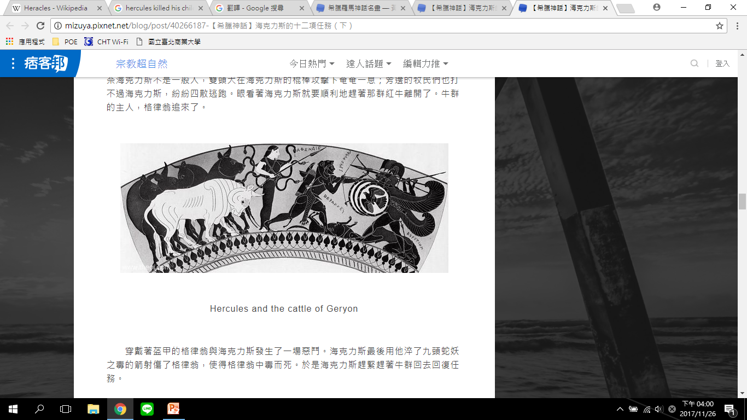
10. Obtain the cattle of the monster Geryon
Notes:
第十個是牽回巨人革律翁的牛群，海力克斯用九頭蛇毒液萃取的箭射向了革律翁，使革律翁中毒身亡後，順利地牽走牛群。

Slide 36
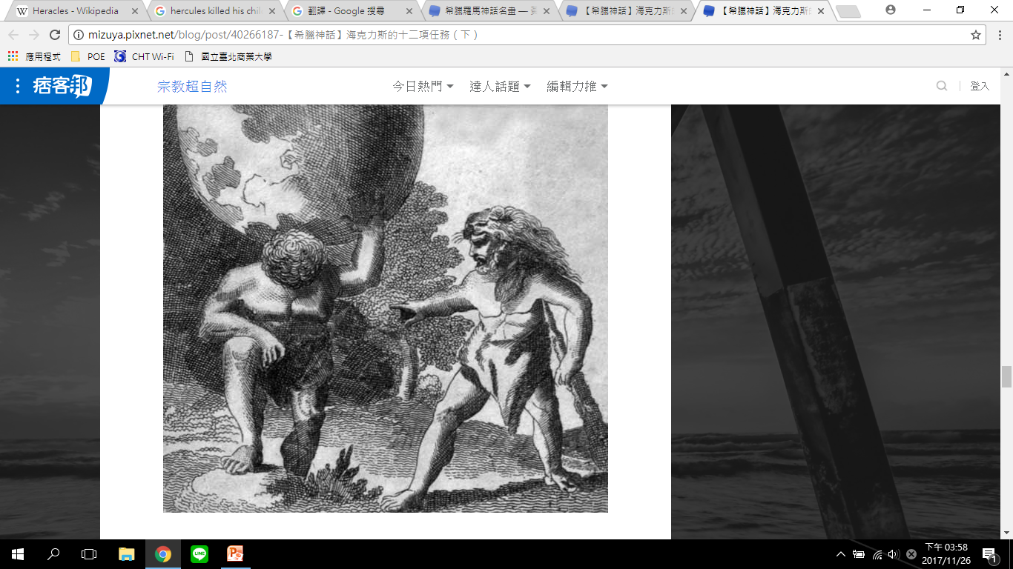
11. Steal the apples of the Hesperides
Notes:
第十一個苦役是摘取赫斯佩里斯的金蘋果，海力克斯在普羅米修斯的協助下，找到了負著天空的神泰坦神亞特拉斯，說服他去女兒們赫斯佩里斯管理的金蘋果園摘三顆金蘋果回來，他承諾暫時幫亞特拉斯頂著天空。

Slide 37
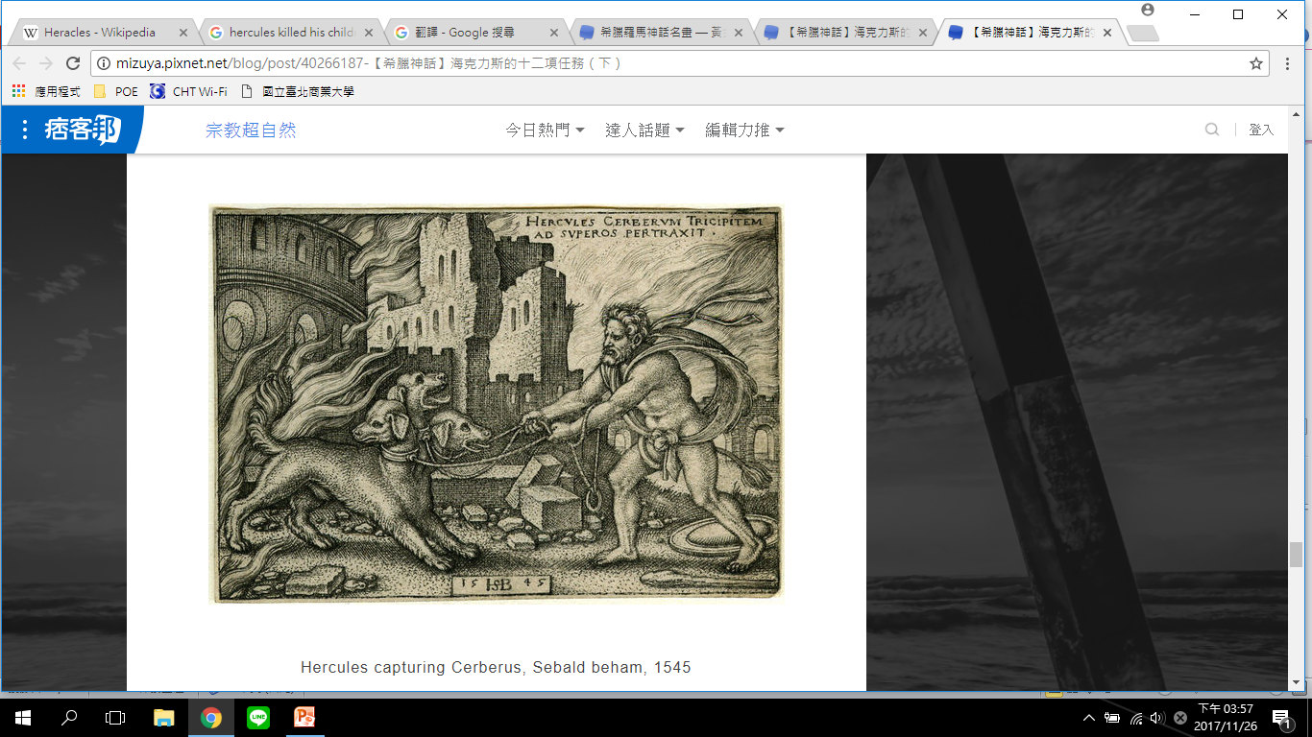
12. Capture and bring back Cerberus
Notes:
第十二個苦役是活捉「地獄三頭犬」賽柏洛斯，冥王黑帝斯同意若海力克斯能赤手空拳打贏賽柏洛斯便可將他帶走。

Slide 38
Further adventures
After completing these tasks, Heracles joined the Argonauts in a search for the Golden Fleece. He also fell in love with Princess Iole of Oechalia. King Eurytus of Oechalia promised his daughter, Iole, to whoever could beat his sons in an archery contest. Heracles won but Eurytus abandoned his promise. Heracles' advances were spurned by the king and his sons, except for one: Iole's brother Iphitus. Heracles killed the king and his sons—excluding Iphitus—and abducted Iole. Iphitus became Heracles' best friend. However, once again, Hera drove Heracles mad and he threw Iphitus over the city wall to his death. Once again, Heracles purified himself through three years of servitude—this time to Queen Omphale of Lydia.
Notes:
之後，在海力克斯完成十二項苦役後，他愛上了俄卡利亞的公主伊俄勒。俄卡利亞之王歐律托斯宣布，能夠在箭術比賽中勝過他的兒子的人可以迎娶伊俄勒。海力克斯獲得了勝利，但歐律托斯卻食言了，他和他的兒子們（除了伊俄勒的兄弟伊菲托斯）藐視海力克斯的優點。海力克斯殺死了國王和他除了伊菲托斯之外的兒子，並誘拐了伊俄勒。後來伊菲托斯成了海力克斯最好的朋友。可惜，赫拉再度讓海力克斯陷入瘋狂，他將伊菲托斯拋向城牆造成了他的死亡。海力克斯為了贖罪，開始成為呂底亞女王翁法勒的三年奴役。

Slide 39
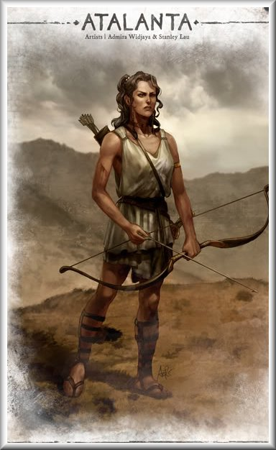
Atalanta
Atalanta was the daughter of Iacus.
Once two Centaurs, swifter and stronger by far than any mortal, caught sight of her when she was alone and pursued her.
Notes:
阿塔蘭塔是伊阿索斯(Iasus)的女兒，也是一名公主，她在大部分的時間都被描述為一位女神。伊阿索斯國王想要一個兒子，所以當阿塔蘭塔出生的時候，他就把她拋棄到山上。一隻母熊負責照顧阿塔蘭塔，直到有一群獵人找到並養育她，她便學會如何像熊一樣打獵和戰鬥。
有一次有兩頭半人馬，比任何截至目前為止的人類來的敏捷和強壯，看見她落單而加以追逐；她並沒有逃跑，她靜靜站著不動，搭起了弓連射出兩箭，兩頭半人馬受傷嚴重，應聲倒地。

Slide 40
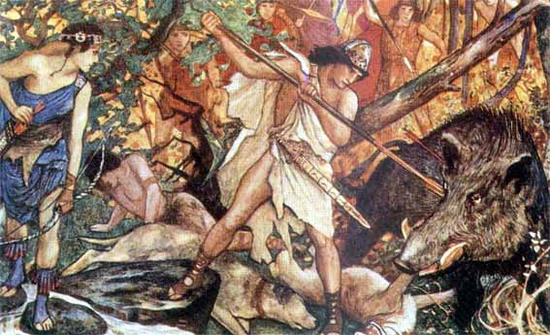
Calydonian Boar Hunt
This was a terrible creature sent to ravage the country of Calydon by Atremis in order to punish the King Oeneus, because he forgot her when he was sacrificing the first fruits to the gods at the harvest-time. The brute devastated the land, destroyed the cattle, killed the men who tried to kill it.
Notes:
接著來到著名的卡呂東野豬狩獵，這頭可怕野豬是被亞特密斯送至卡呂東國來報復處罰國王俄紐斯，因為他在收獲時節，獻祭第一批水果給諸神時，忘記了亞特密斯，這頭凶猛野豬蹂躪土地、殘害牛隻、殺了試圖殺害牠的獵人。
最後俄紐斯尋求希臘最英武的勇士協助，組成一隊非凡的年輕英雄，阿塔蘭達也加入其中。

Slide 41
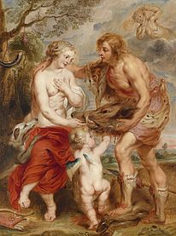
A shining buckle clasped her robe at the neck.
Her hair was simply dressed, caught up in a knot behind.
An ivory quiver hung upon her left shoulder and in her hand was a bow. Thus was she attired.
As for her face, it seemed too maidenly to be that of a boy, and too boyish to be that of a maiden.
Notes:
有這樣一句話形容她在這男性集聚而成的隊伍中的風範：「閃亮扣環緊繫她的袍子在項間，她的秀髮挽以髮結為飾垂頸後；象牙箭筒掛左肩而單手持一弓，裝束英武似男容顏嬌嫩又似女。」
然而對俄紐斯的兒子梅列阿格而言，阿塔蘭達比他曾經見過的任何少女更看來可愛而更使他傾心，他對她一見鍾情。但是阿塔蘭達待他如志同道合好友，而不可能視為情人。除非做為狩獵的夥伴，她不喜歡男人而且決定絕不婚嫁。

Slide 42
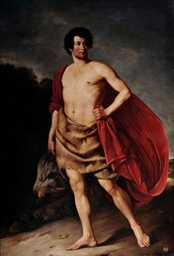
Meleager
Some of the heroes resented her presence and felt it beneath them to go hunting with a woman, but Meleager insisted and they finally gave in to him. It proved well for them that they did, because when they surrounded the boar, the brute rushed , and Atalanta kept her head and wounded the boar. Her arrow was the first to strike it. Meleager then rushed on the wounded creature and stabbed it to the heart. Technically speaking it was he who killed it, but the honor of the hunt went to Atalanta and Meleager insisted that they should give her the skin.
Notes:
有些英雄很憤怒阿塔蘭達的參與，並覺得與一個女人外出打獵有失身分，但是梅列阿格堅持而英雄們最後對梅列阿格讓步。他們的讓步證明了他們決定正確，因為在他們包圍野豬時，野豬敏捷地衝向他們，當其他人前來救援時，牠已殺死了兩個人，而同樣不祥的是第三個人被偏向的長矛給射傷。在這種英雄垂死與武器胡亂飛舞的混亂下，阿塔蘭達保持冷靜並傷了野豬；她的箭最先射中野豬，然後梅列阿格衝向受傷的野豬刺入牠的心臟。技術上來說是他殺了野豬，可是獵殺的榮耀歸之於阿塔蘭達，而梅列阿格堅持應把豬皮給阿塔蘭達。
在梅列阿格剛一周大時，命運之神出現在他母親阿爾緹雅前，丟入一塊木頭入她的火爐中燃燒。她們唱道：喔！剛出世的小孩，我們賜你一項禮物，
願你長命百歲直到此塊木頭燃燒成灰燼。阿爾緹雅從火中搶救出燃燒中的木頭，弄熄了火焰，並把它藏在櫃子內。
阿爾緹雅的兄弟在那些獵殺野豬的隊伍中，他們覺得受辱且對把獎品給了女生極度憤怒；毫無疑問地，其他人也有同感，但是他們是梅列阿格的舅舅們，在禮節上和他不需有立場。他們宣稱阿塔蘭達不應得到豬皮，而且告訴梅列阿格說他和任何人一樣，沒有權利把豬皮送人。不久之後，梅列阿格趁他們完全疏於防備。把他們都殺了。
消息傳到阿爾緹雅，她的鍾愛兄弟被她的兒子所殺，因為兒子為一位跟著男人打獵的女人，做了愚蠢的事。一股盛怒湧上心頭，她衝到櫃子取出木頭丟入火中。當木頭被點燃，梅列阿格倒地而死，而在木頭燃成灰燼，梅列阿格的靈魂從他的軀殼溜走。

Slide 43
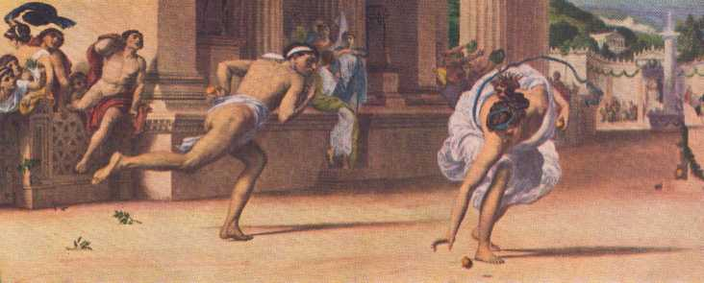
Racing
It was after this achievement that she discovered who her parents were and went to live with them, her father apparently being reconciled to having a daughter who really seemed almost if not quite as good as a son.
It seems odd that a number of men wanted to marry her because she could hunt and shoot and wrestle, but it was so; she had a great many suitors.
Notes:
在建立功業之後，阿塔蘭達發現她的雙親是誰，而前去一起生活，她的父親顯然滿意有個女兒真的幾乎和男兒一樣傑出，卻不是完全相同。許多男生因為她會打獵、射箭、與摔角而要跟她結婚，似乎很奇怪；但是事實就是如此，她有許多追求者。她神情自若，為了輕易與令人滿意地處理這些追求者，她宣稱不管誰能跑贏她，她會嫁給他，她也完全知道沒有這麼一個男人，健步如飛的年輕人常常跑來跟她競賽，她老是把他們拋在後頭。

Slide 44
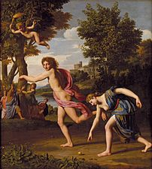
But at last one came who used his head as well as his heels. He knew he was not as good a runner as she, but he had a plan. . By the favor of Aphrodite, this ingenious young man, whose name was either Melanion, got possession of three wondrous apples, all of pure gold, beautiful as those that grew in the garden of the Hesperides.
Melanion won the race and Atalanta married him.
Notes:
但是最後有一位會動腦人出現，他知道無法跟阿塔蘭達跑的一樣快，但他有個謀略。這位有想法的年輕人，名叫梅拉尼翁；藉由艾妃黛特的協助。艾妃黛特給了年輕人三棵奇妙的純金蘋果，跟長在赫斯佩里斯果園的那些金蘋果一樣漂亮，沒有人曾經見過更別說擁有了。
比賽開始前，他保持頭腦清晰，緊握著他的金蘋果。比賽一開始，阿塔蘭達像箭般飛快，他直接在阿塔蘭達前滾出一個金蘋果時，她正跑贏過他；她彎腰撿拾漂亮金蘋果需要些許時間，但是短暫的停留，讓他並駕齊驅。又過一會兒，他丟出第二顆，這一次稍微偏了點，阿塔蘭達必須徒然改向去撿拾，他就超前了。可是幾乎在同時，阿塔蘭達已經趕上他，而終點目前已近在咫尺。然而第三顆金蘋果閃著金光，掠過她的跑道前，從場地旁滾進了遠方的草地。阿塔蘭達看見翠綠草地閃著金光，她無從抗拒而去拾起金蘋果。她的對手氣喘吁吁，而幾乎上氣接不了下氣地抵達終點。阿塔蘭達屬於年輕人了，她在森林內獨自一人的自由逍遙日子與運動的勝利榮光告一段落。

